Slide 1
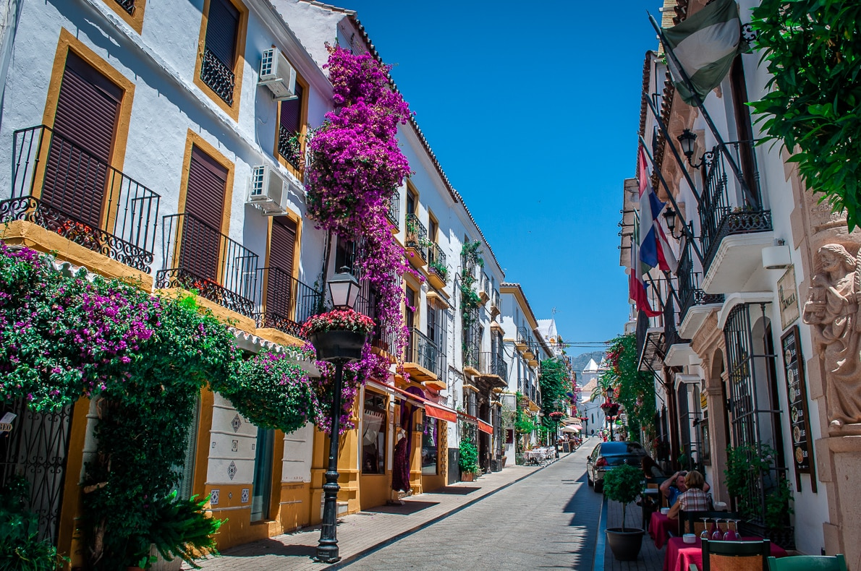
Spain presentation
Haru, Keito Kaminaka
Notes:
Hello, we introduce Spain!! What image do you have?

Slide 2
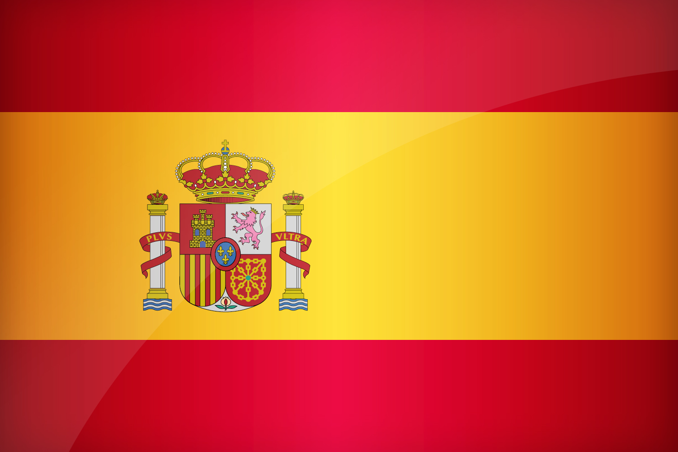
outline
About Spain
Introduction (etiquettes, geography & history, the reason)
Culture
Hobby
People
Food
Conclusion
Kahoot time!!
Notes:
This is an outline of our presentation. We have a Kahoot time, so listen carefully.

Slide 3
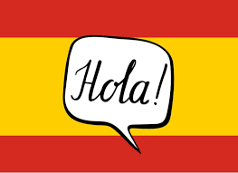
About Spain
Spanish population
46,794,125(2022)
Spanish main city
1:Madrid(6,713,557), 2:Barcelona(5,658,472) 3:Valencia(796, 549)
This means about 25% of people live in these three cities.
in case of Japan...
Main language
Spanish
However, some region try to use their own language and
be independent.
It is same result!! 25%

Slide 4
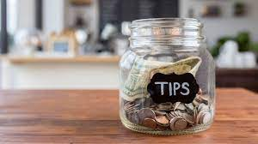
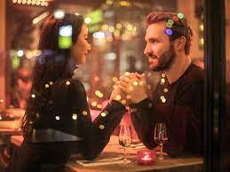
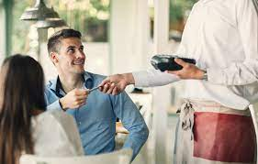
Introduction (etiquettes)
・The Tipping...How do you expect about Spanish tipping?
The answer is zero.
Spanish restaurant worker are
given living wages and health benefits.
Man have to pay the bill
It is partly same as Japan,
but Spanish people have to pay every date time.

Slide 5
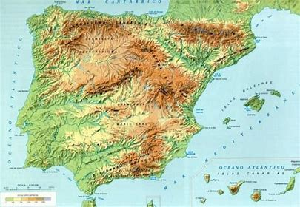
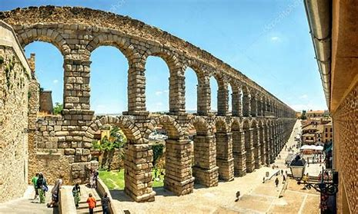
Introduction(geo &history)
Spanish Geography
・Located in Iberian peninsula
・Surrounded by Mediterranean sea and
Atlantic ocean
・Shares a border with Portugal and France
Spanish History
・A long history
・Territory of Roman Empire
・Age of Discover

Slide 6
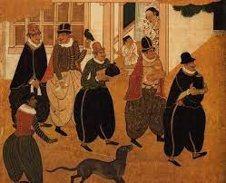
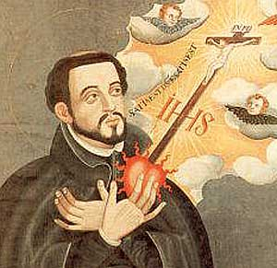
Introduction(the reason)
The reason why we chose Spain
Spain and Japan have a deep relationship.
・The first European people who Japanese met
・The trade between Japan and Spain
・A Strong impact to 15th Japanese people
Totally different country
・Far away from Japan
・Not knowing about Spain
Spanish people
Famous missionary

Slide 7
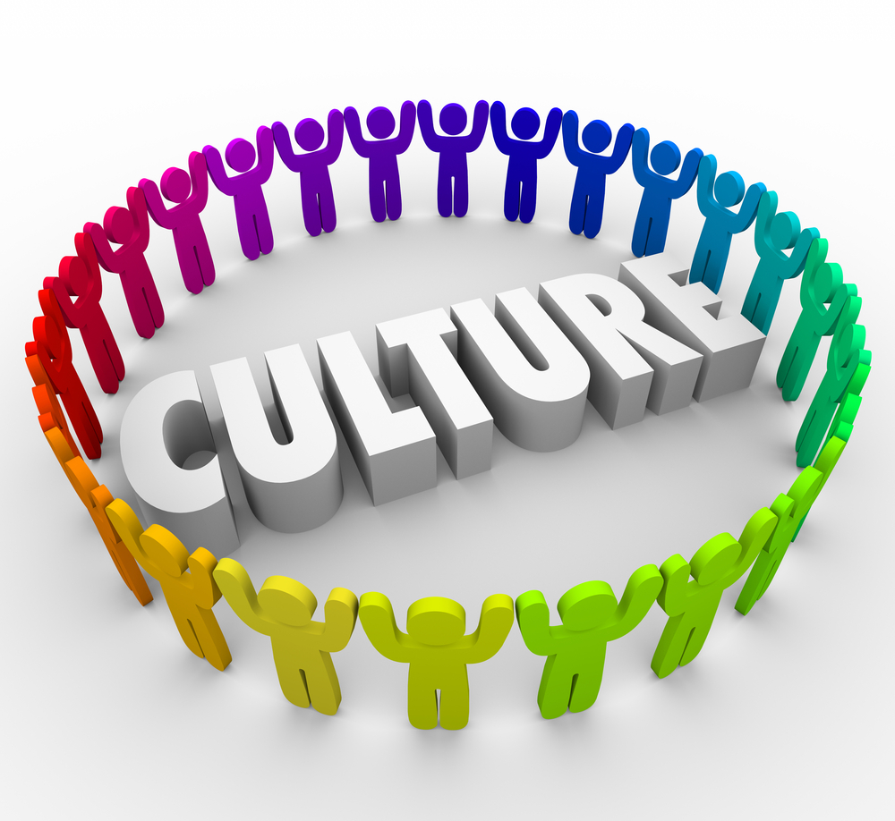
Spanish Culture
Cultural dimensions
Surprisingly…
the results are almost same!!
We thought the figures are completely different.
Especially, we surprised at “power distance”
➡The number is about the same.
Among the results, one noticeable figure “Masculinity”
➡The Spanish score is 42, Japanese one is 95
It means in Spain, women is stronger than men

Slide 8
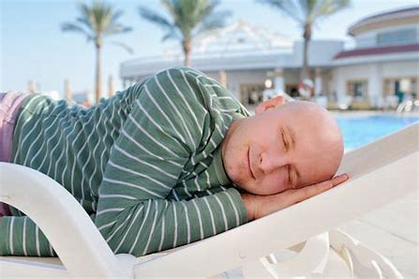
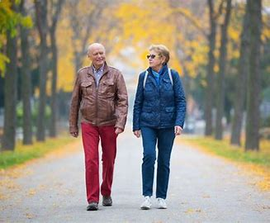
Spanish Hobby
Among Spanish people, the popular hobby is…
Siesta and walking!!
SIESTA is a Spanish traditional nap style.
In urban area, people don’t do siesta, but in
rural area, people still do it.
WALKING is just a walking. Spanish people
like walking.
In my opinion, Spanish building are really
beautiful, so they don’t get bored walking.

Slide 9
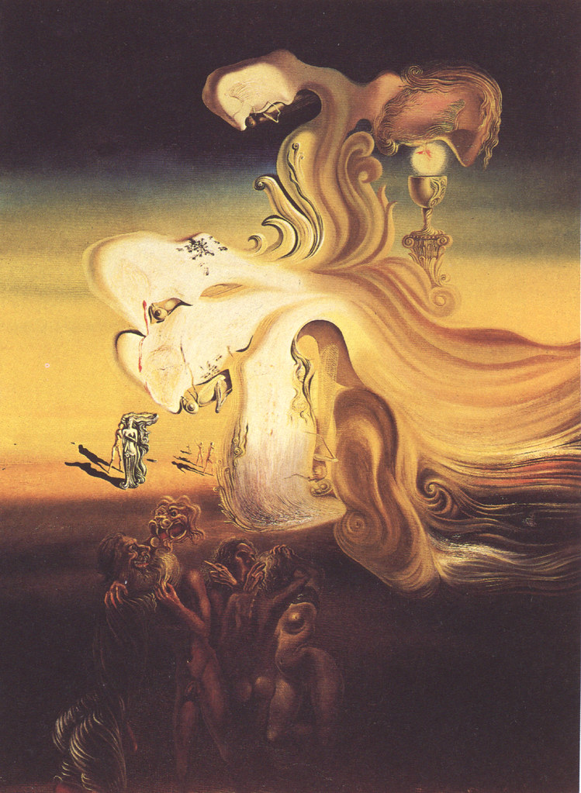
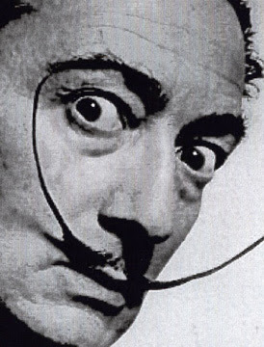
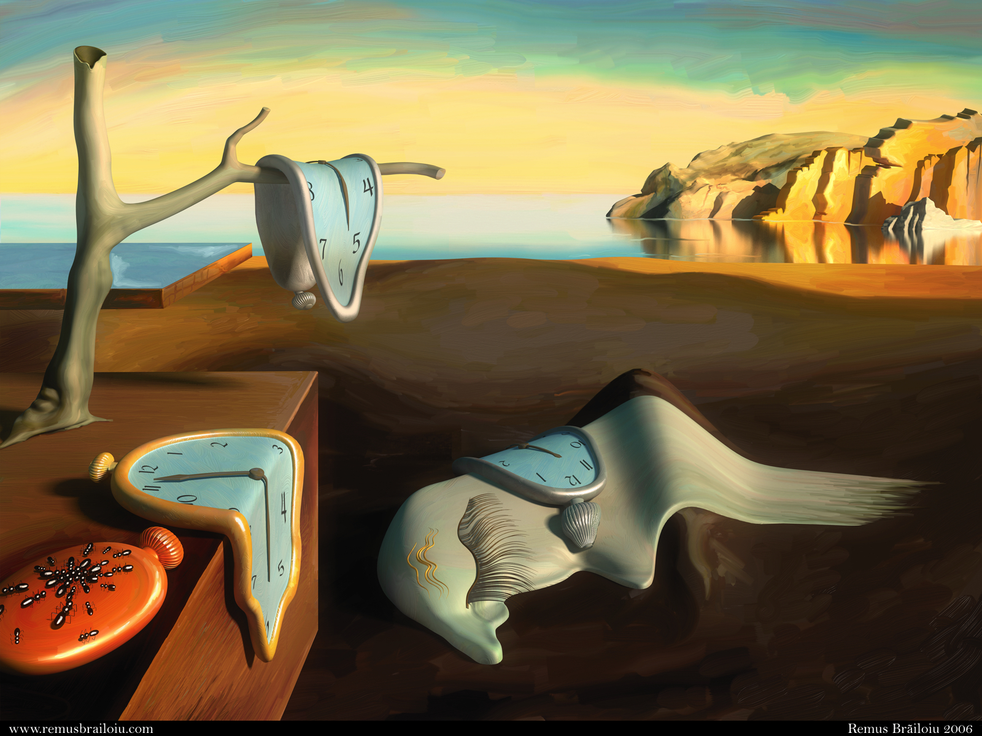
Famous Artist
Salvador Dali
From Figueres, Catalonia, Spain.
He made a lot of magnificent arts and had great influences for people in the world.
He had strange mustache it also attracted many people who don’t know well about him.
The most famous artwork is
“La persistencia de la memoria”

Slide 10
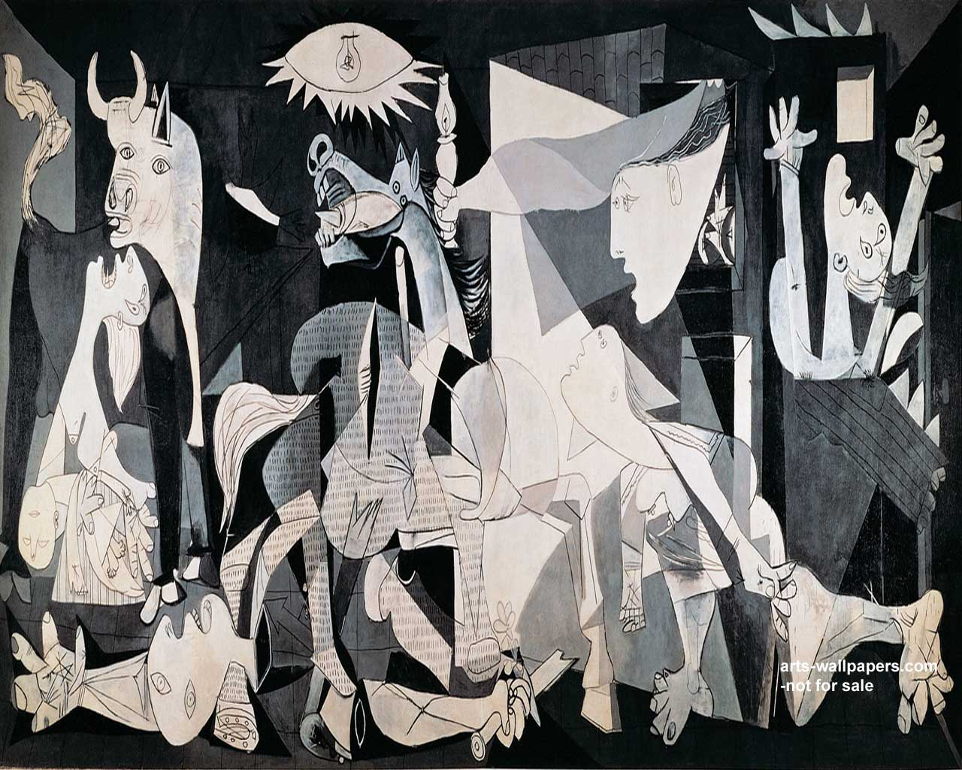
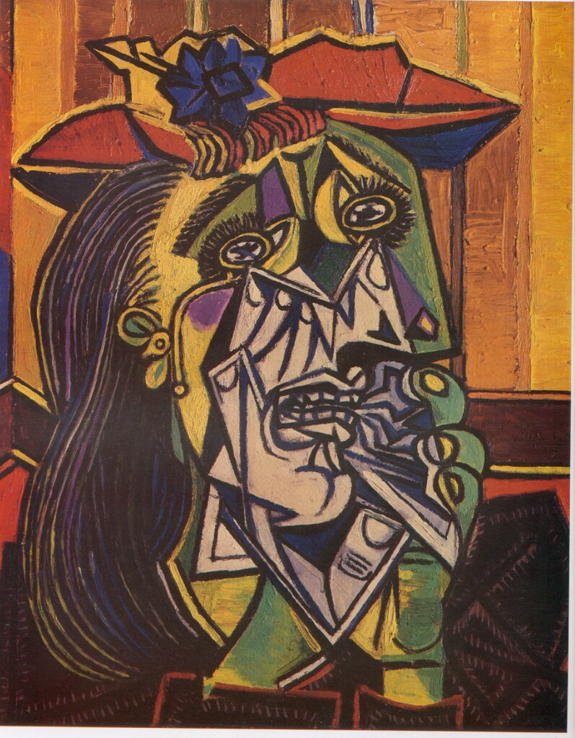
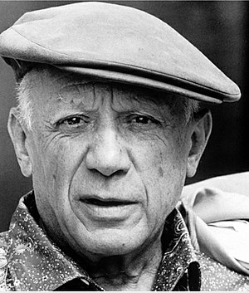
Famous historical people from Spain
Pablo Picasso
From Málaga, Spain.
The greatest artist of the 20th century
“Guernica” is one of the most famous his artworks and it protested about anti-war.
He left very important things for us such as terrible history of the war.

Slide 11
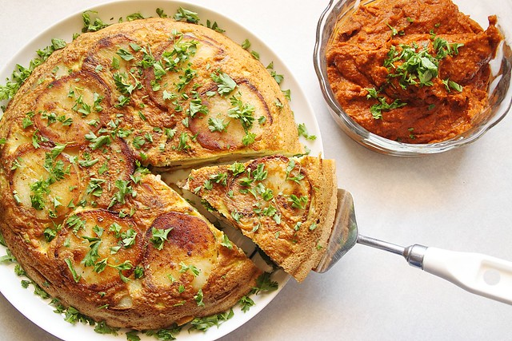
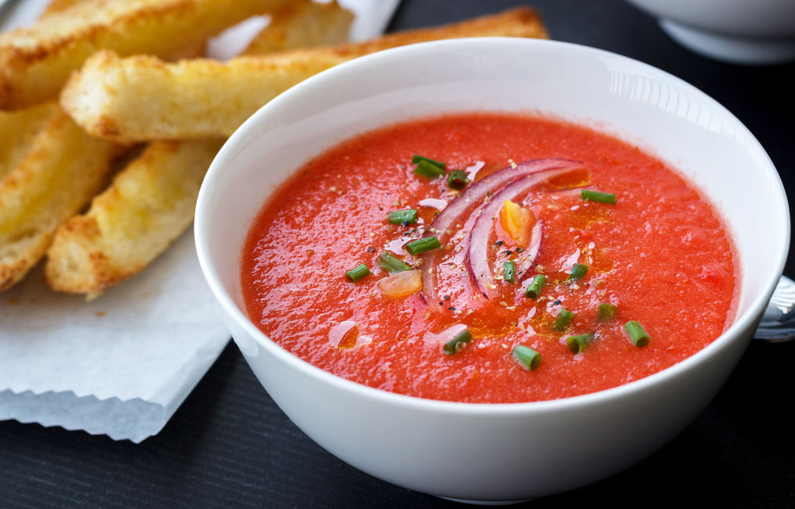
Traditional Spanish Food
Gazpacho
Spanish Tortilla
Cold soup like a tomato soup
Including bred, garlic, vinegar, cucumber, and tomatoes
During summer times
Kind of omelet
Made by Joseph de Tena Godoy in February 1798
Shape like a hole cake

Slide 12
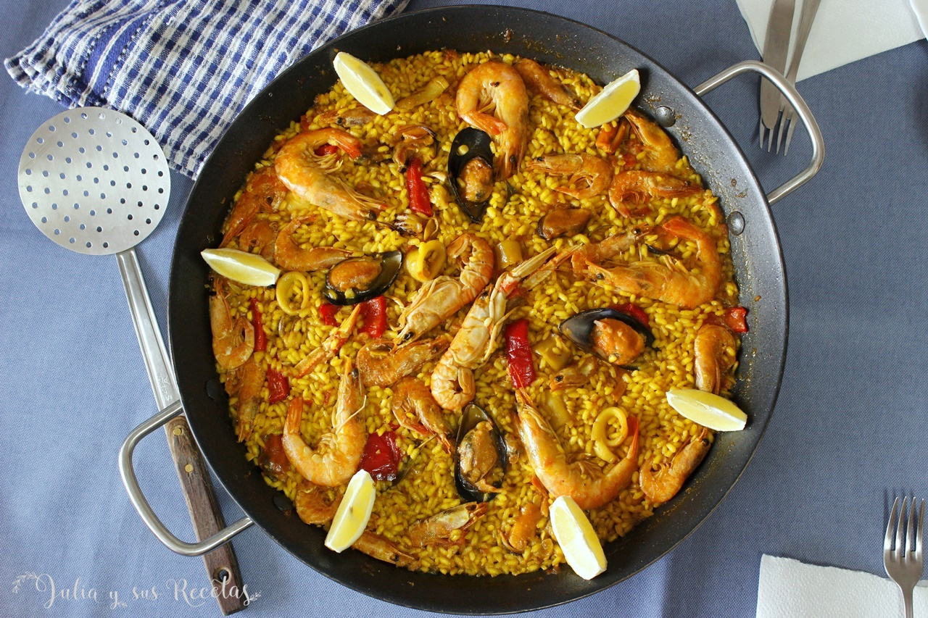
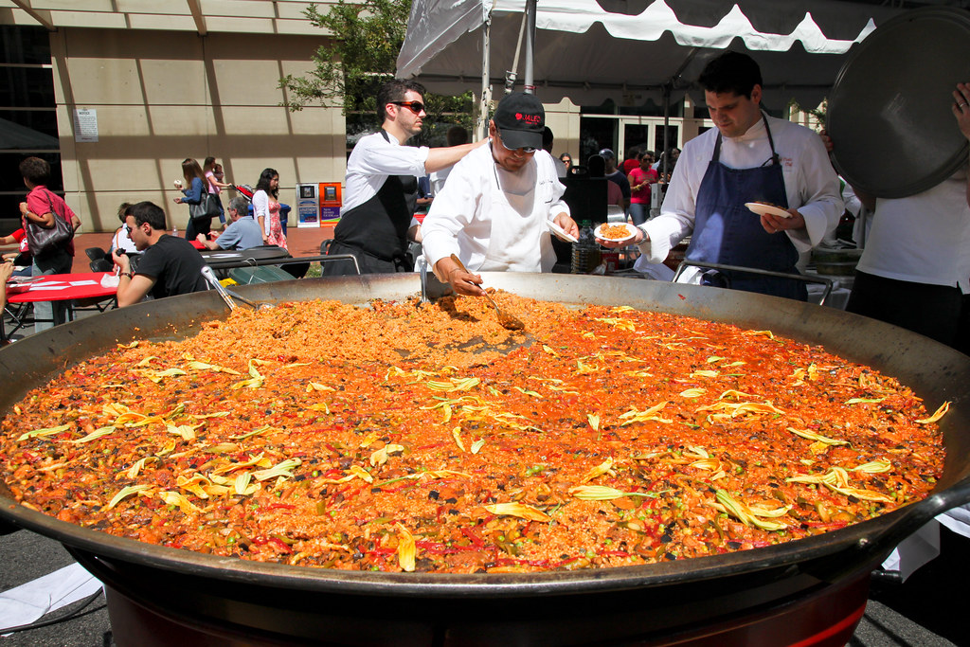
Traditional Spanish Food
Paella
Very famous in the world
Origin from Valencia
Paella festival
Paella has vegetables, seafoods, meats and rice

Slide 13
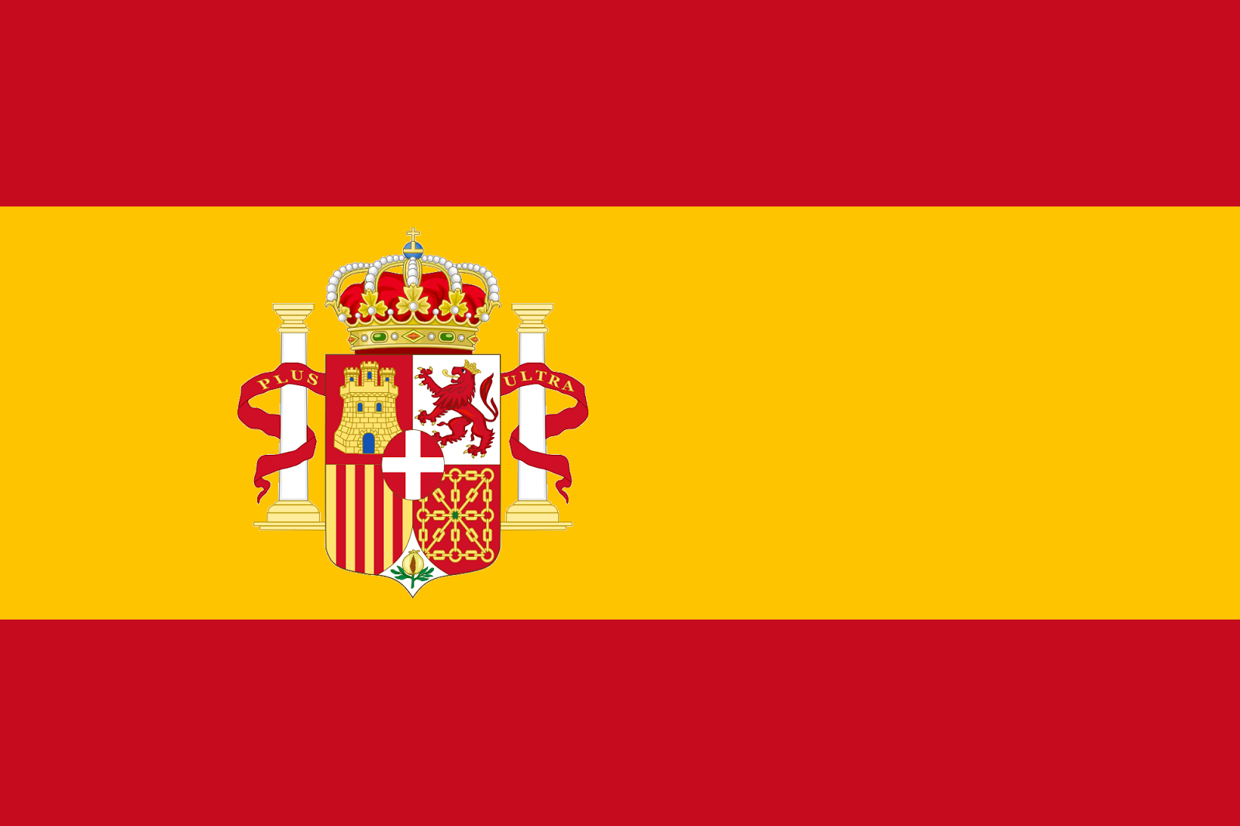
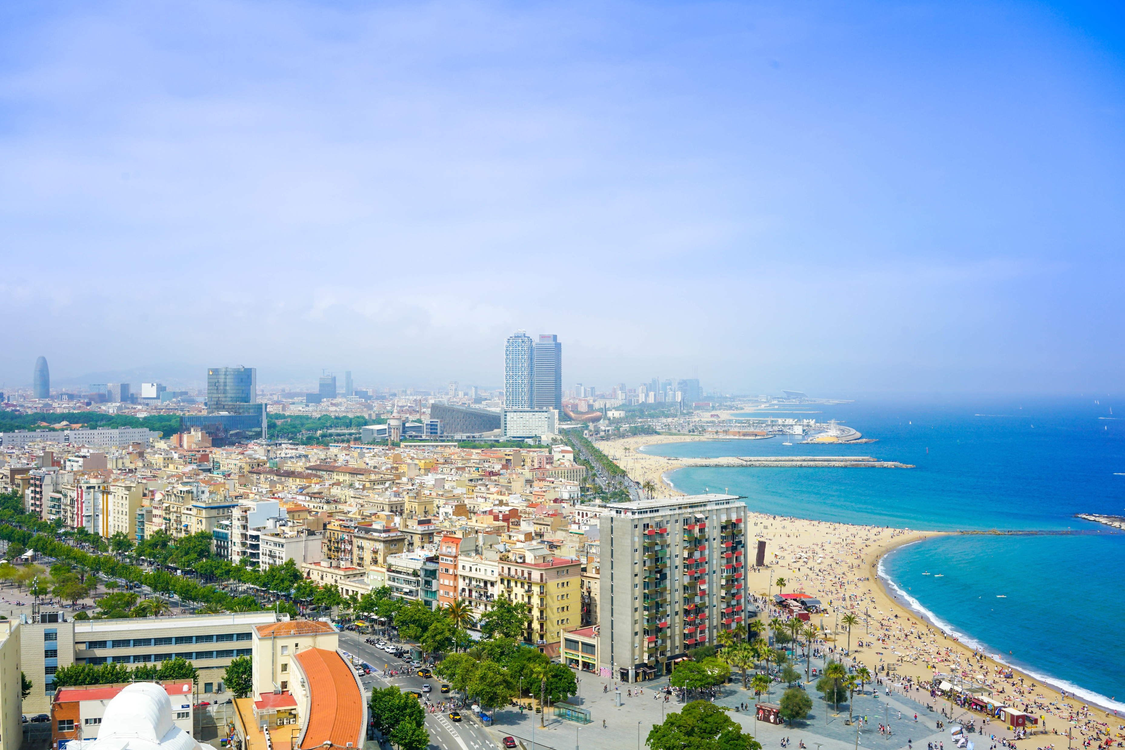
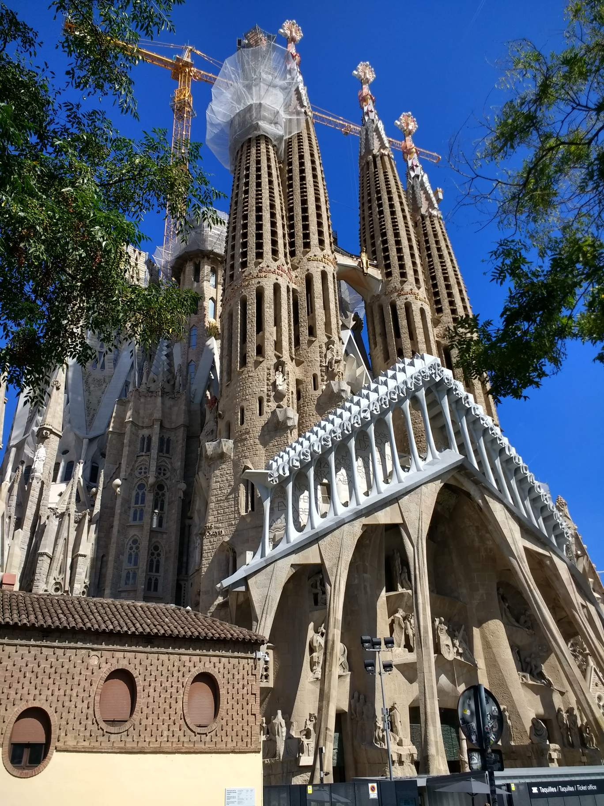
Conclusion
Spain and Japan were thought to be completely different countries
Any famous people have been present in Spain.
Food culture, it is completely different from Japan.
The use of materials and the way of flavors have developed a different.

Slide 14
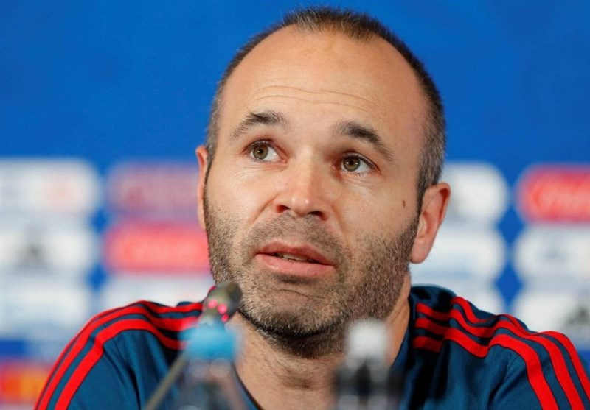
Thank You
Thank You

